Slide 1

Statistics Midterm Review

Slide 2
Population vs. Sample

Slide 3


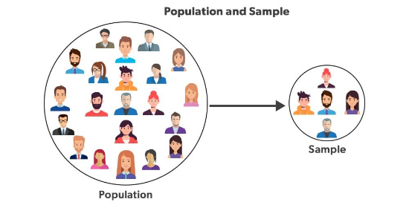
Population vs. Sample
Definitions
Population: The entire group you want to know about. (Parameter)
Sample: The subset of the population you actually measure. (Statistic)
Measure | Population | Sample
Mean | μ | x
Std Dev | σ | s

Slide 4

Key Concepts
Fundamental And Powerful Concepts
Three Rules of Statistics
Statistics: Making smart decisions when info is incomplete, giving us the tools to measure and handle uncertainty.
Descriptive: Using raw data to interpret reality by collection, description, or analysis.
Before calculating anything, visualize the data. Then look for:
Probability: Realm of Randomness where it always works out in the long run.
Inference: Forming estimates/judgments about populations from random samples.

Slide 5
Key Concepts
Fundamental And Powerful Concepts
Three Rules of Statistics
"Draw a picture. Draw a picture. Draw a picture."
Statistics: Making smart decisions when info is incomplete, giving us the tools to measure and handle uncertainty.
Descriptive: Using raw data to interpret reality by collection, description, or analysis.
Before calculating anything, visualize the data. Then look for:
Shape (Skew, Modality)
Probability: Realm of Randomness where it always works out in the long run.
Center (Mean, Median)
Spread (SD, Variance)
Inference: Forming estimates/judgments about populations from random samples.

Slide 6



Describing Data
Shape
Center
Spread
Skewness:
Mean: Average. Sensitive to outliers. Moves toward the skew.
Range: Max - Min.
Right Skewed (Positive): Tail points right.
Variance: Average squared deviation from the mean.
Median: The middle value. Robust against outliers.
Left Skewed (Negative): Tail points left.
Standard Deviation (SD): Square root of Variance. (Typical distance from mean).
Mode: Most frequent.
Modality: Unimodal vs. Bimodal.

Slide 7


Five Number Summary
Calculating Outliers
1.
Minimum
The "1.5 Rule":
2.
Q1 (25th Percentile)
Median (50th Percentile)
3.
4.
Q3 (75th Percentile)
5.
Maximum

Slide 8

Probability Basics
Definitions
Theoretical Probability:
Sample Space: Set of ALL possible outcomes.
Event Space: The subset of outcomes we care about.
Experimental Probability:
Law of Large Numbers:
Example: Rolling less than a 4 on a die. Sample={1,2,3,4,5,6}, Event={1,2,3}. P=3/6=0.5

Slide 9
Probability Basics
Key Concepts
Definitions
Theoretical Probability: What math predicts (e.g., 50% for heads).
Sample Space: Set of ALL possible outcomes.
Event Space: The subset of outcomes we care about.
Experimental Probability: What actually happens in trials.
Law of Large Numbers: As you increase trials, Experimental Prob approaches Theoretical Prob. "Bad luck can't beat infinity."
Example: Rolling less than a 4 on a die. Sample={1,2,3,4,5,6}, Event={1,2,3}. P=3/6=0.5

Slide 10




Probability Rules
AND Rule
OR Rule
Independent Events: One event does NOT affect the other.
Mutually Exclusive: Events cannot happen at the same time.
Example: Two coin flips.
Example: Rolling a 2 OR a 5.

Slide 11
Random Variables
Discrete RV
Continuous RV
Data you can COUNT.
Data you can MEASURE.
Usually Whole Numbers
Can take any value (decimals).
Number of heads in 3 flips.
Weight of a newborn baby.
Number of cats in a shelter.
Exact amount of snow in Houghton.

Slide 12

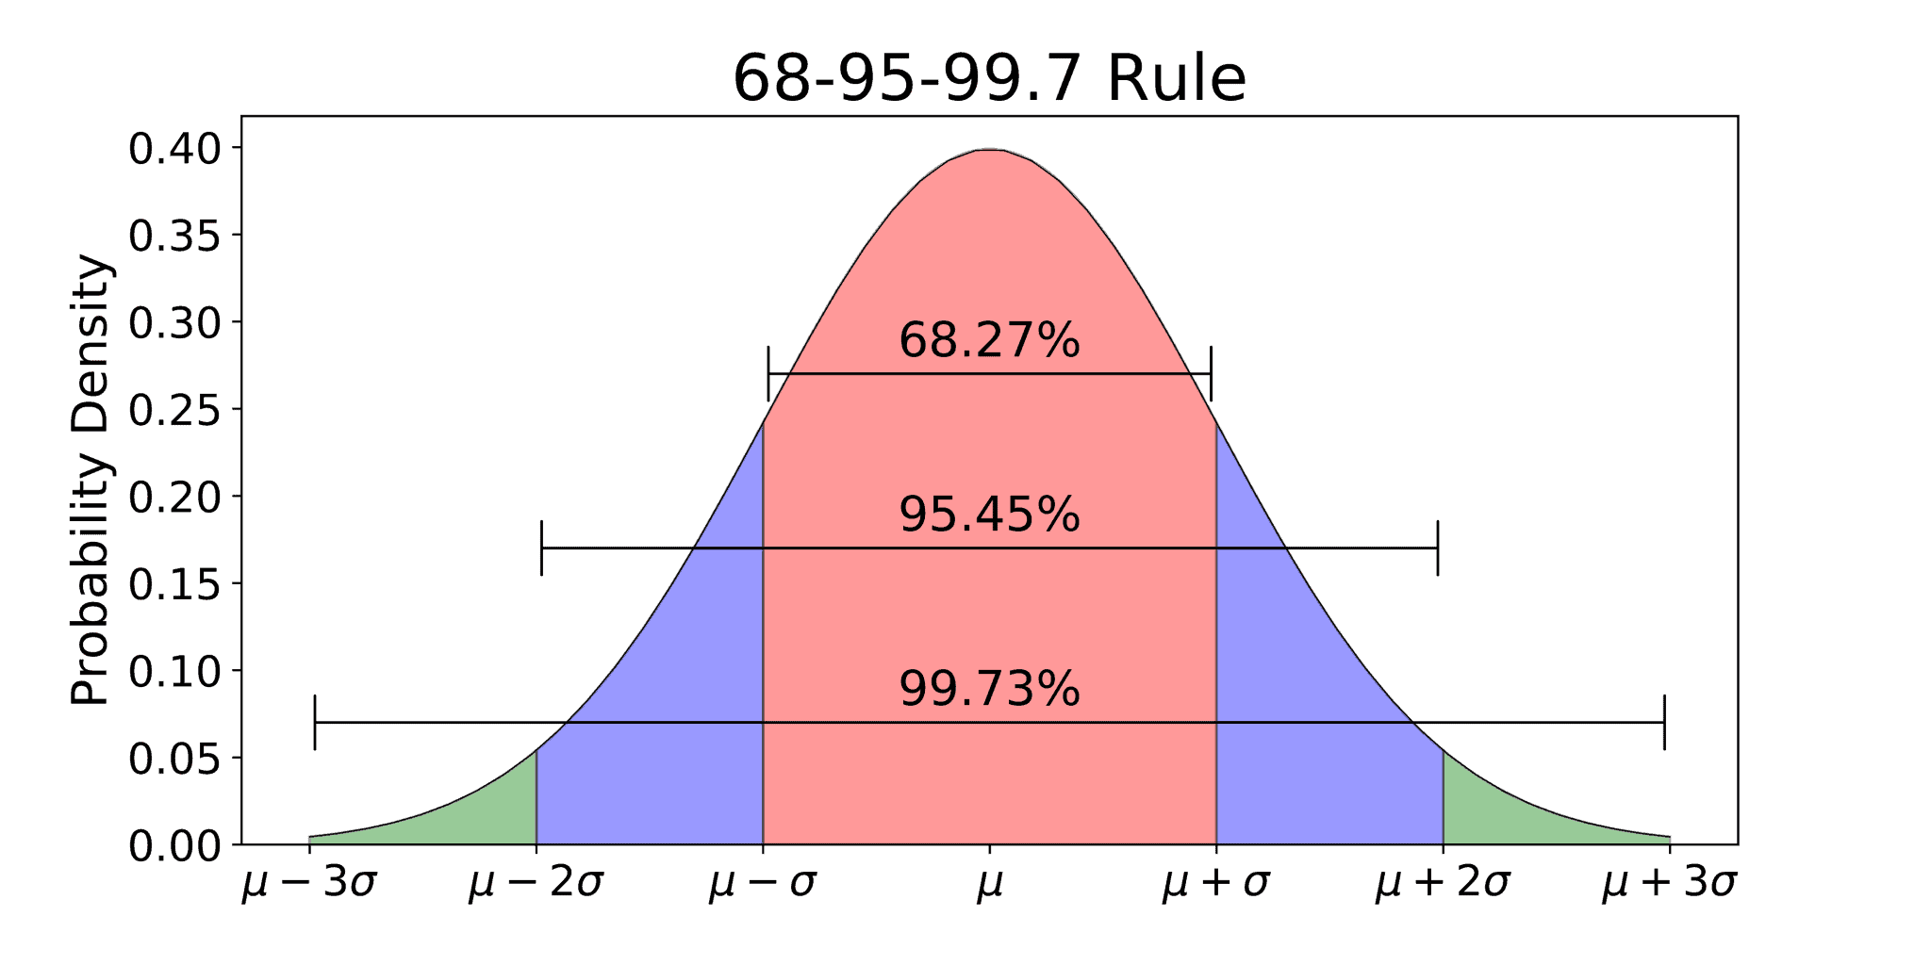
The Normal Distribution

Slide 13

Z-Scores
Definition
A Z-score tells you how many Standard Deviations a data point is from the Mean.
It allows us to compare "apples to oranges" by standardizing different datasets onto the standard normal curve.
Subtract the mean, and divide by the standard deviation.

Slide 14

Central Limit Theorem (CLT)
The Concept
Standard Error
Even if your population is skewed, uniform, or weird...
Standard error is a measure of how much the sample mean is expected to vary from the population mean.
If you take enough large random samples, the distribution of the sample means will be Normal.

Slide 15
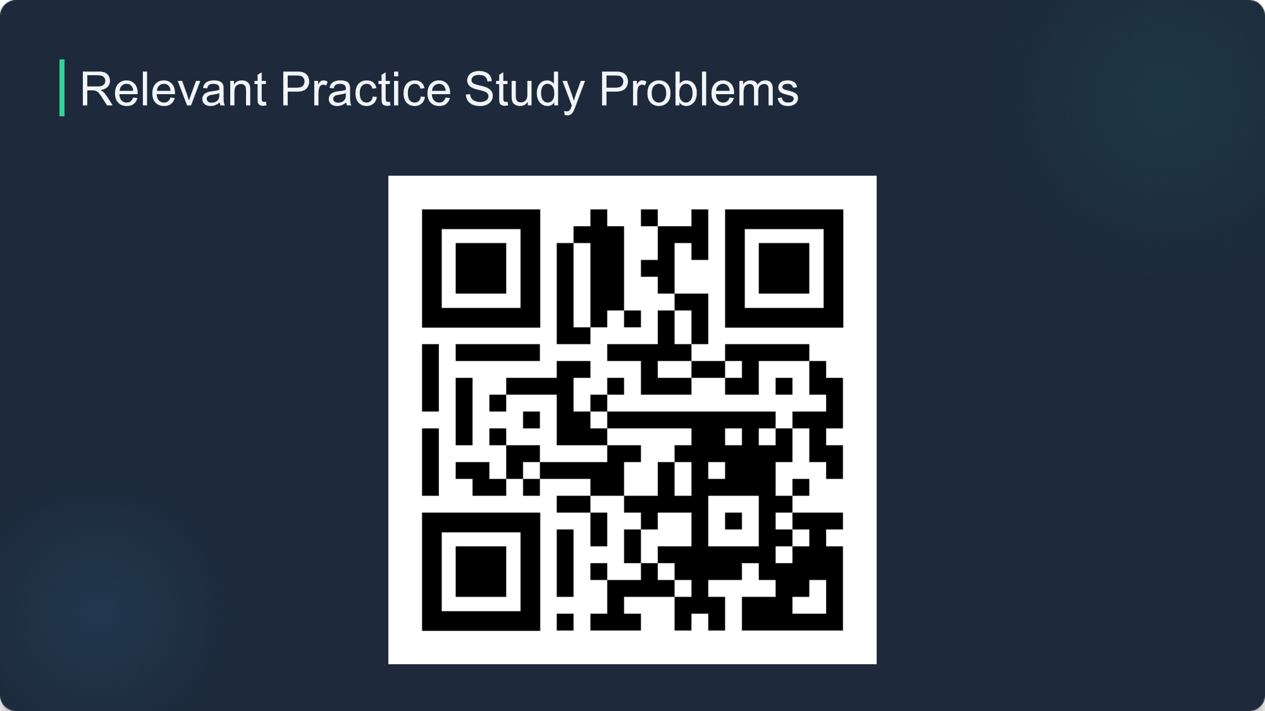

Slide 16

Image Sources
https://media.geeksforgeeks.org/wp-content/cdn-uploads/20220302154028/Group-13.jpg
https://www.ztable.net/wp-content/uploads/2020/11/68-95-99.7-rule-normal-distribution-2048x1024.png

